Slide 1
Thanksgiving Day
A holiday about giving thanks

Slide 2
History
On September 16, 1620, a group of people called Pilgrims left England because King James I did not permit religious freedom. He forced everyone to belong to the Church of England. The Pilgrims boarded a ship called the Mayflower and set sail for America.
They sailed for 66 days
On November 21, 1620 (2 months later) the Pilgrims arrived to America.

Slide 3
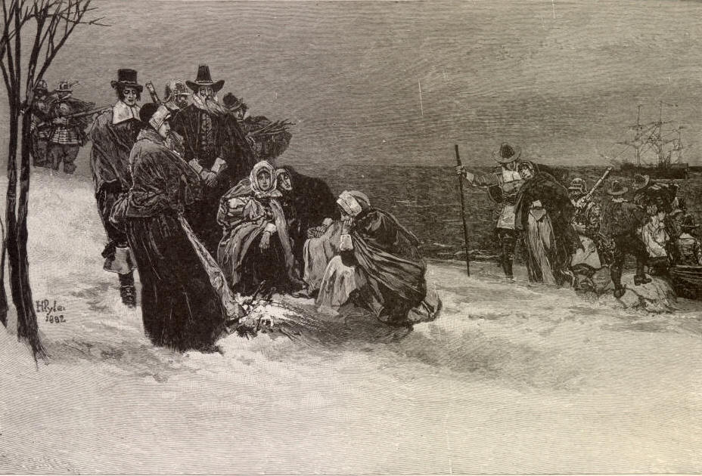
The first winter
The first winter was very cold and difficult for the Pilgrims
Many of them were sick and did not have enough food to eat
Half of the Pilgrims did not survive the first winter

Slide 4
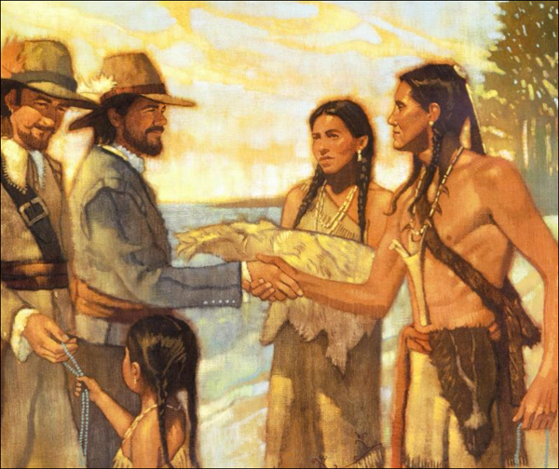
Native Americans
The Pilgrims met a friendly Native American Tribe called the Wampanoag Tribe
The Native Americans taught the Pilgrims how to live and survive
They gave the Pilgrims seeds for corn and taught them how to plant crops for food
They also taught them how to hunt and fish for food

Slide 5
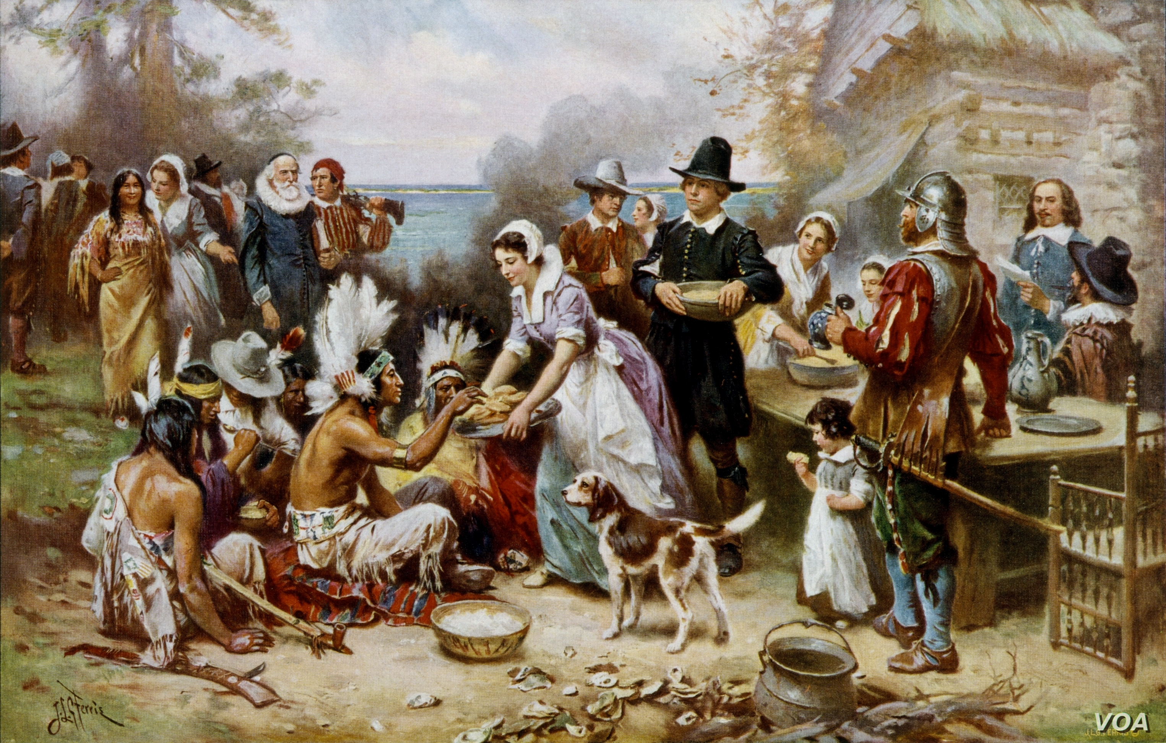
The first Thanksgiving Feast
In the fall, the Pilgrims harvested their crops
They were very grateful to the Native Americans for teaching them how to survive off the land
The Pilgrims and the Native Americans had a feast to give thanks for their food and their friendship

Slide 6
Pilgrim and Native American relations
Unfortunately, the positive relationship between Pilgrims and Native Americans did not last very long
For modern Wampanoag people Thanksgiving is a reminder of betrayal and bloodshed

Slide 7
Thanksgiving today
Thanksgiving Day in the USA is celebrated on the fourth Thursday of November
It began as a day of giving thanks and sacrifice for the blessing of the harvest and of the preceding year
Since 1924, in New York City, the Macy's Thanksgiving Day Parade is held annually every Thanksgiving Day
Professional football games are often held on Thanksgiving Day
The day after Thanksgiving Day is known as Black Friday, the beginning of the Christmas shopping season and the day for the chaotic sales
Every year the President of the USA „pardons” a specially selected turkey

Slide 8
Macy’s parade
Football match
Black Friday

