Slide 1
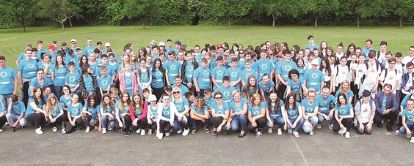
Antun Matija Reljković
Elementary school

Slide 2
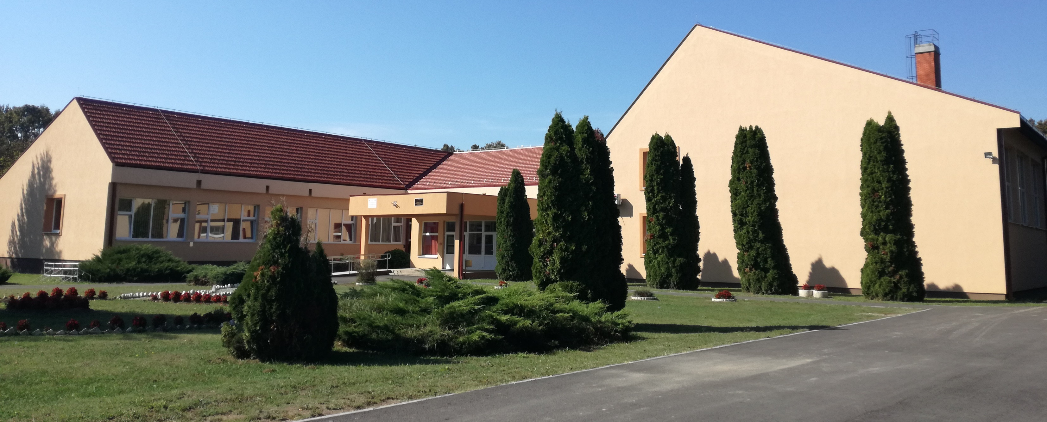
Our school consists of main school Bebrina and six small village schools in Kaniža, Kuti, Banovci, Dubočac, Šumeće and Zbjeg
At this moment it has got 379 students

Slide 3
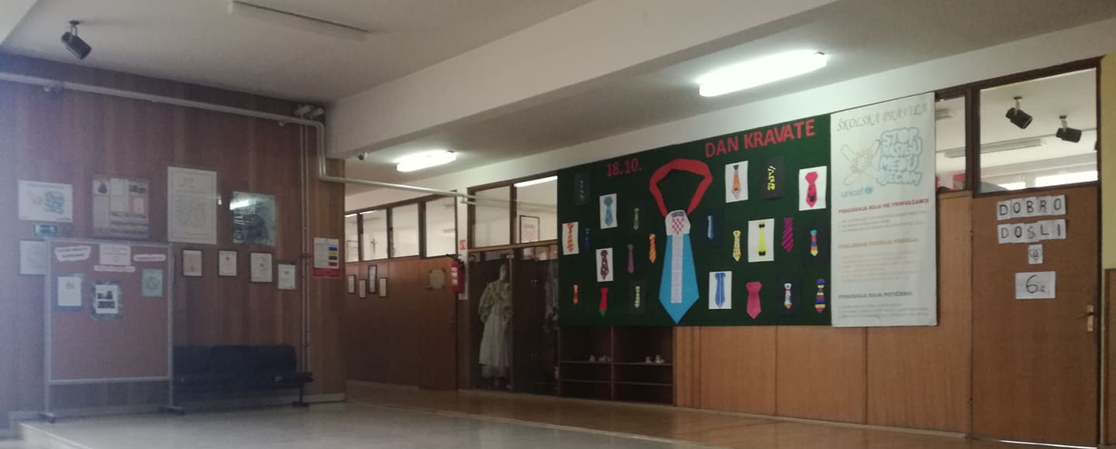
This is our main hallway
We use our main exihibition board for important days, memories, holidays…

Slide 4
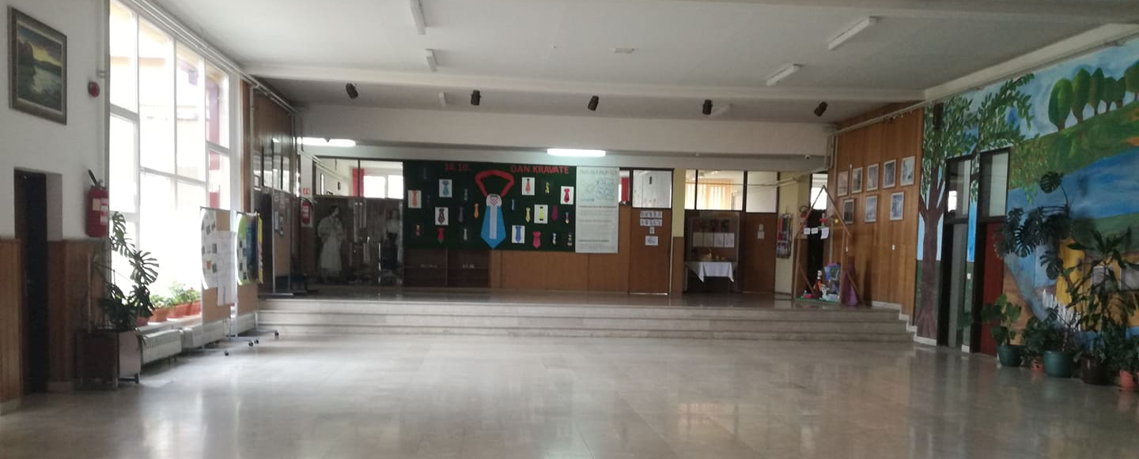
Our students decorated our walls in classrooms and hall

Slide 5
This is our small hallway
We use it to show students works about selected topics

Slide 6
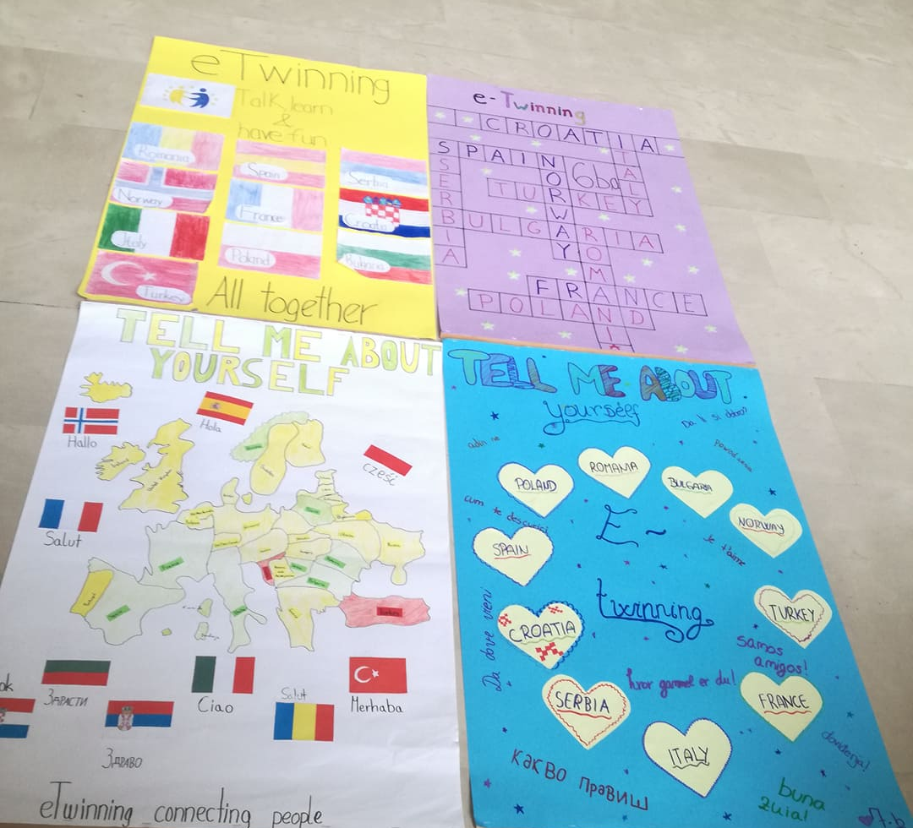
A lot of our students are in this project
These are some of their posters

Slide 7
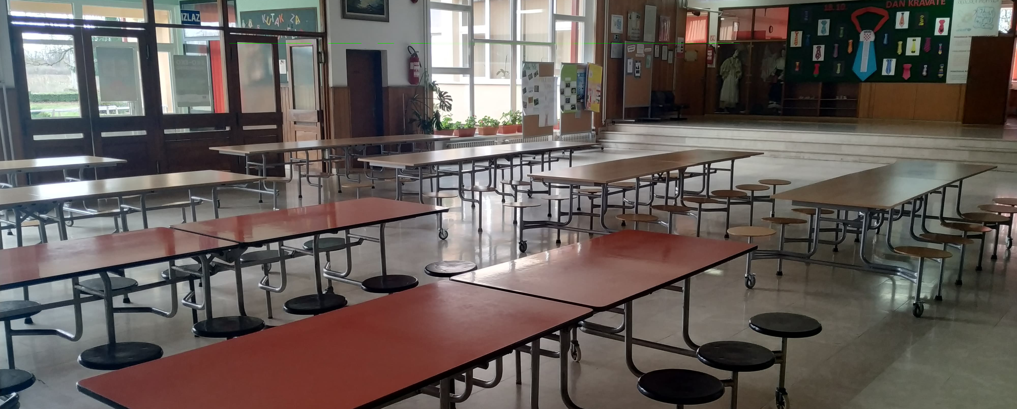
This is our canteen

Slide 8
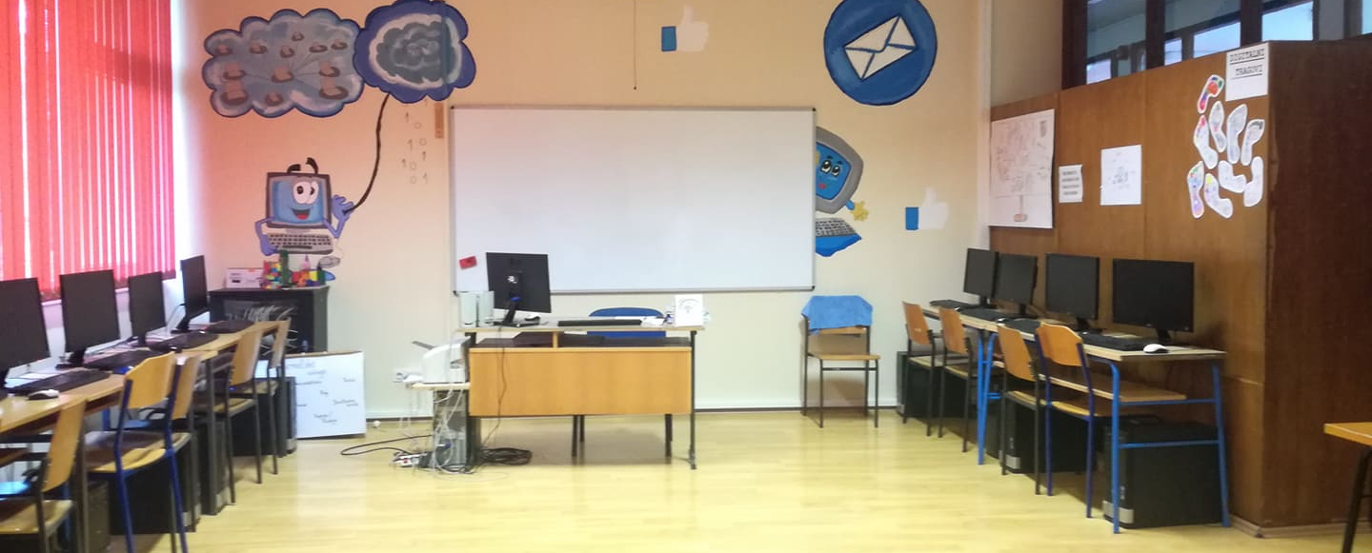
Our IT classroom
Also decorated by students

Slide 9
Our gym

Slide 10
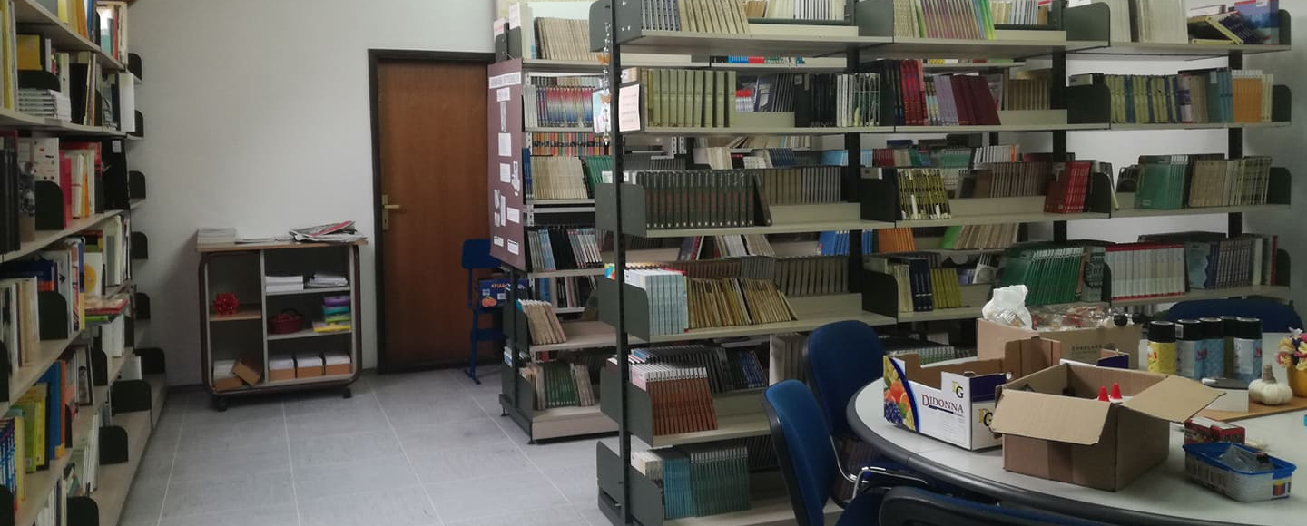
Our library

Slide 11
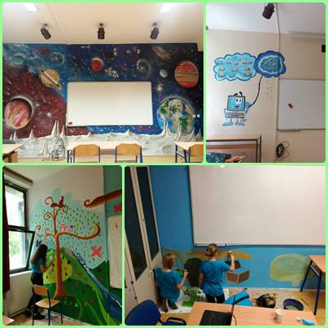
This is a process of beautifyng the classrooms
Our school has been a partner in a project called eco eco volunteer. This is a part of that project

Slide 12
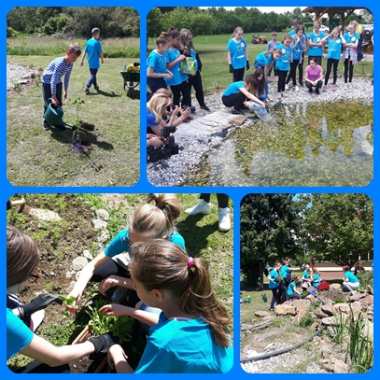
Students, teachers, parents and support staff together made a pond behind the school with outdoor classroom
Here they release fish into the pond

Slide 13
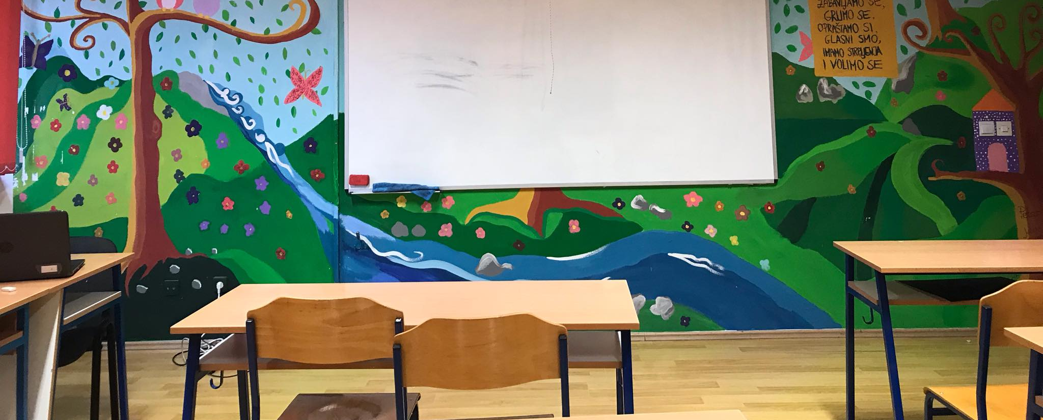
This is our classroom

Slide 14
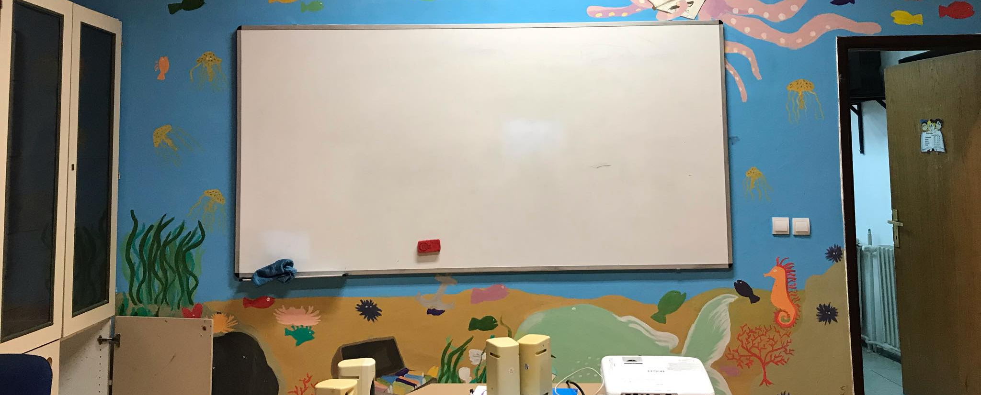
Some of our other classrooms

Slide 15
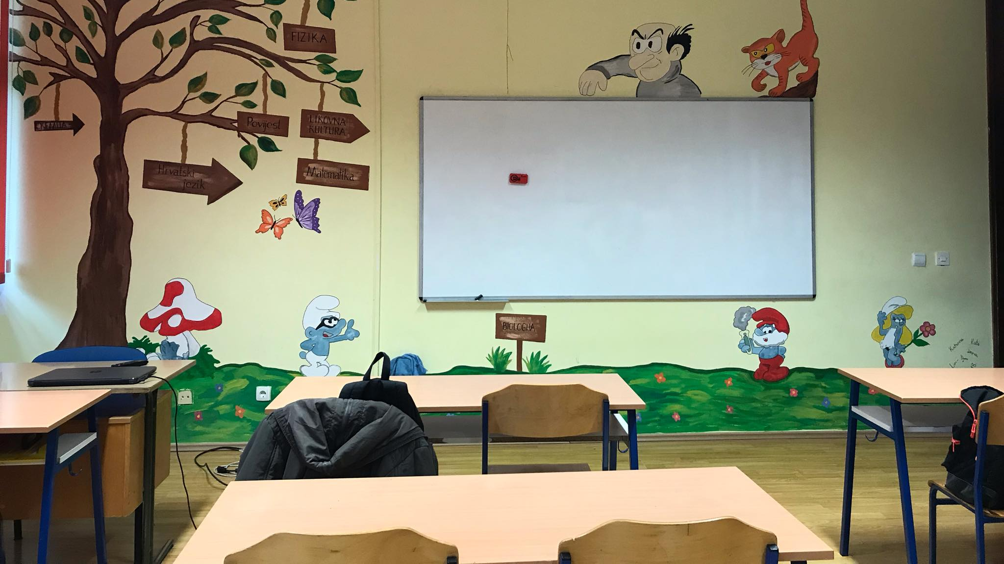

Slide 16
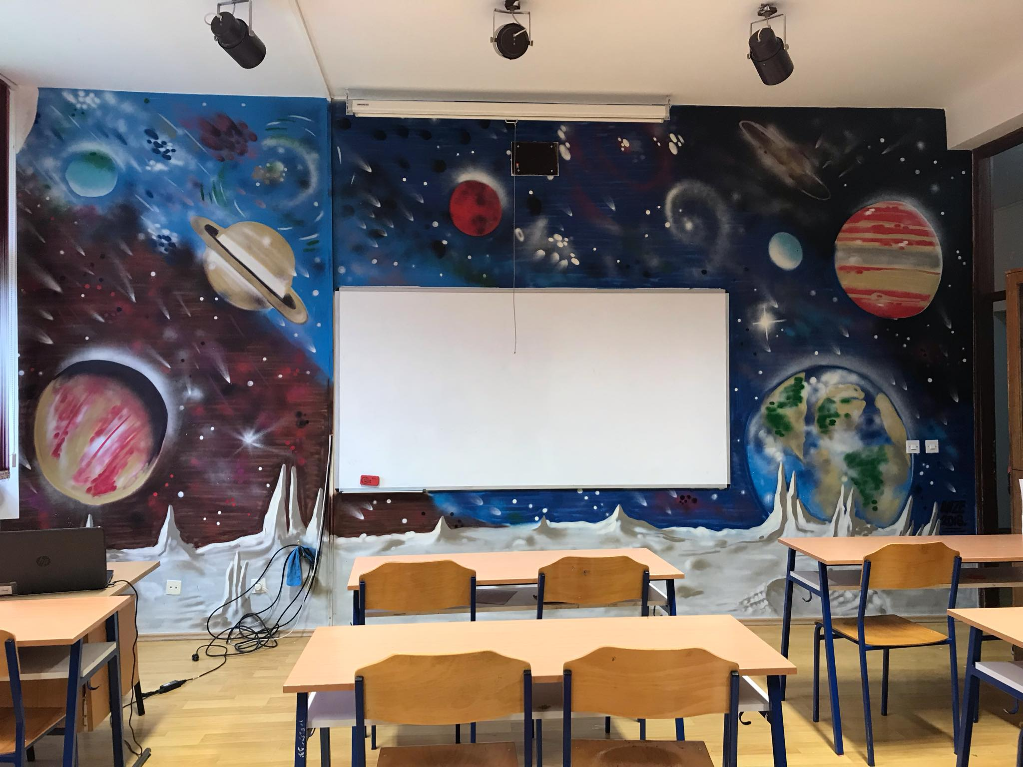

Slide 17
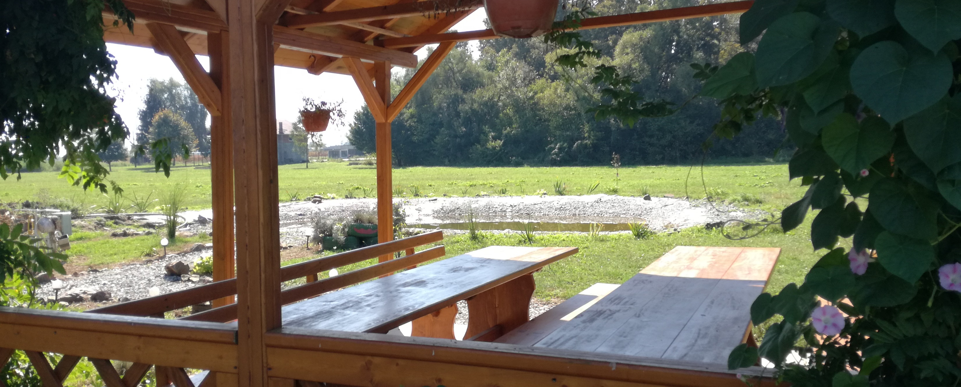
Our outdoor classroom

Slide 18
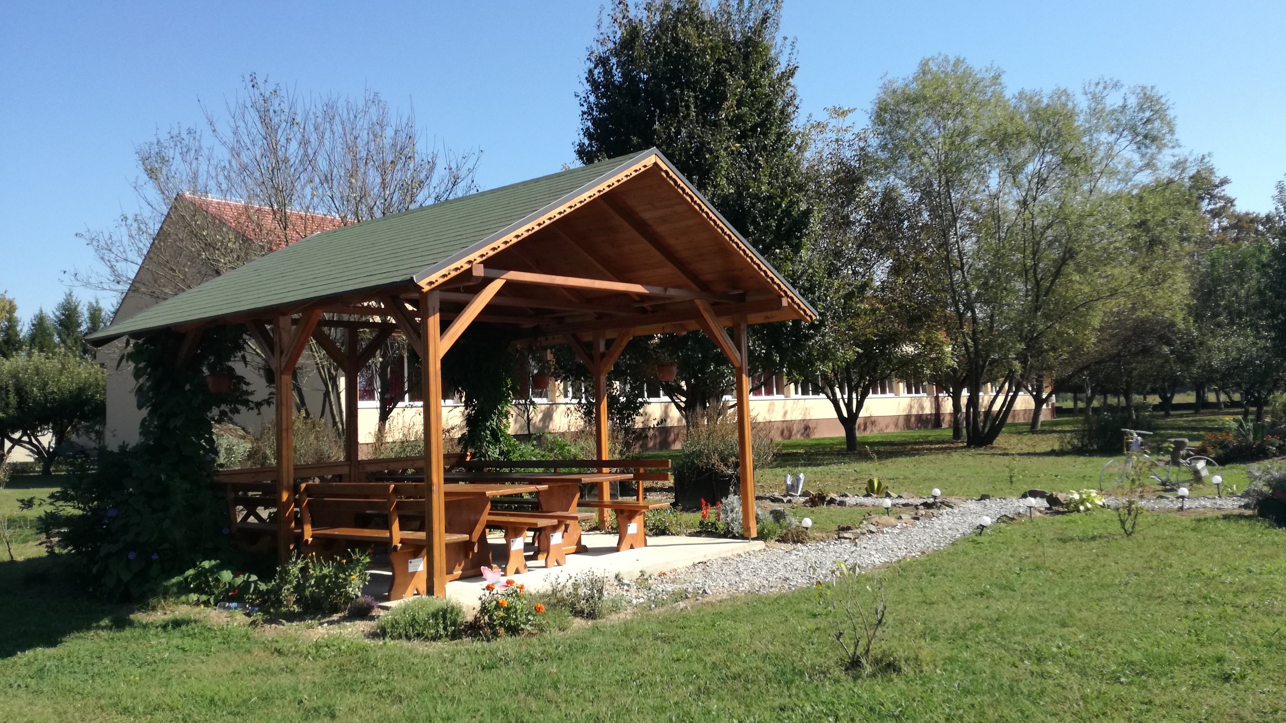

Slide 19
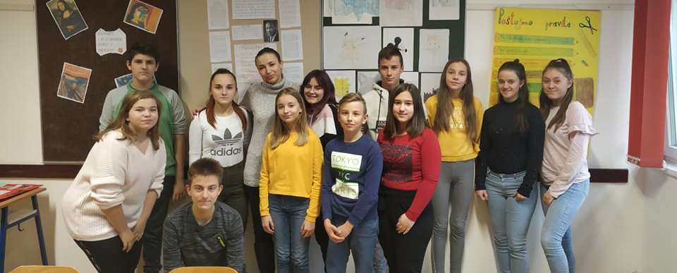
Our 7.a grade

